Slide 1
Dashboard of tableau Project (Covid-India Analysis)

Slide 2
Objectives
Creating a dashboard of covid-19 India data.
Covid is spreading day by day through all over India

Slide 3
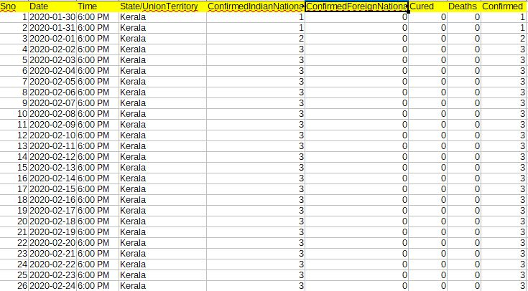
DATA SET
Data set contain details from 30 Jan 2020 to 28 Apr 2021
It contains 9 column & 14230 rows.

Slide 4
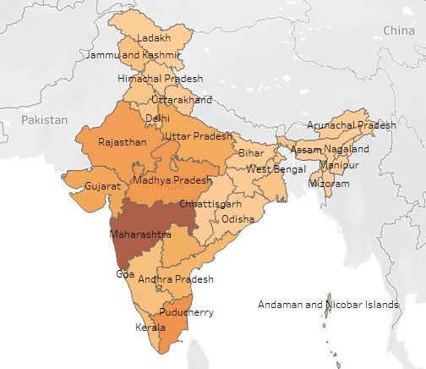
Covid India
Spreading of covid in all over India

Slide 5
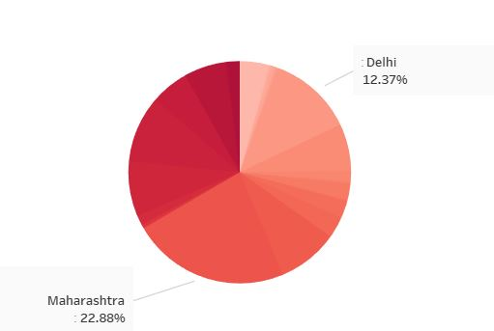
Percentage distribution of cases
Maharashtra has the max percentage of confirmed case among the other state of india

Slide 6
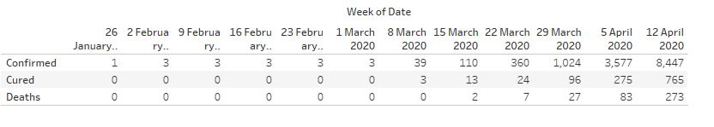
Weekly details
The highest no of confirmed case is 8447 on 12 April

Slide 7
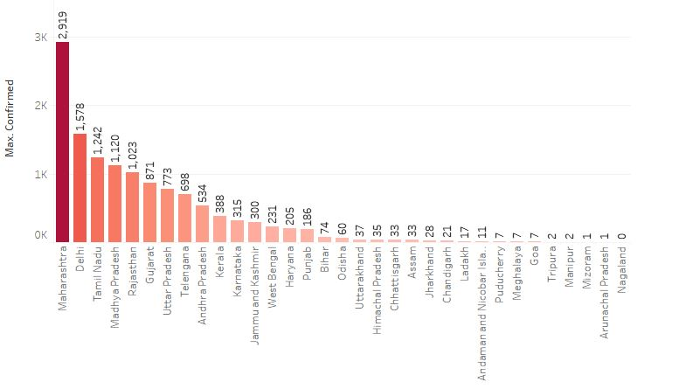
Most & Least effected state
Maharashtra is the most effected state while Nagaland is the least effected state of India

Slide 8
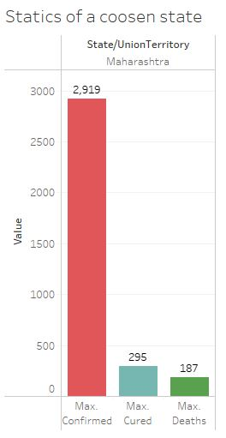
Statics of Maharashtra
No of confirmed case in Maharashtra is 2919
Max cured cases is 295
Max Death is 187

Slide 9
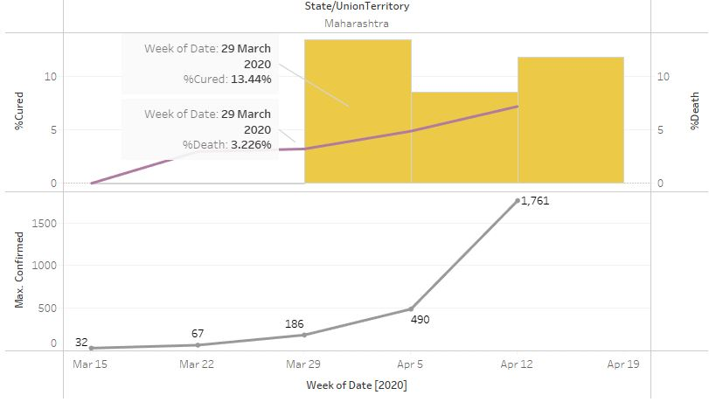
On 29 march 2020 the percentage of cured cases is 13.44%
And the percentage of death was 3.22%

Slide 10
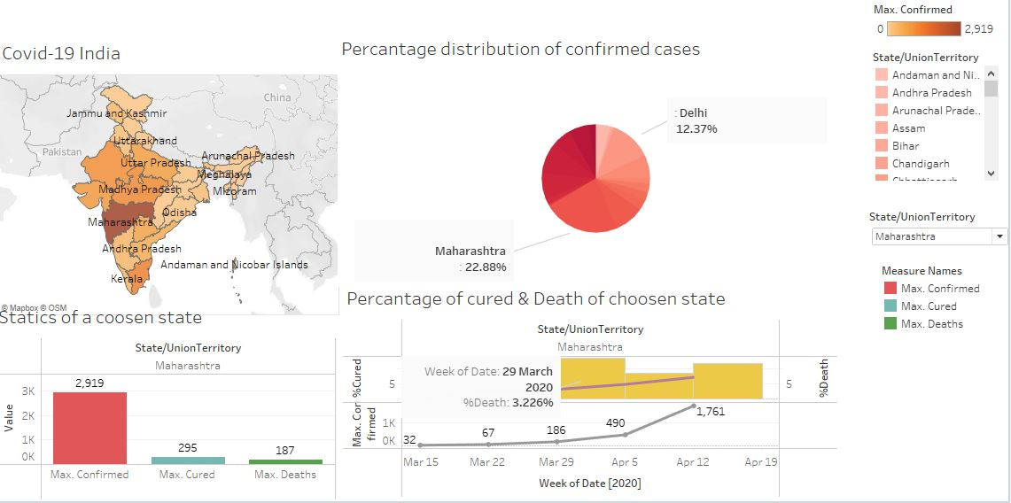
Covid dashboard

Slide 11
Conclusion
Max no of cases noted in Maharashtra
Least Effected state is Nagaland
Max no of death noted in Maharashtra
Link of detail analysis is given below
https://drive.google.com/drive/u/0/folders/1cKiAh61ZEsbKYi_k7iEBQBCBtZ5K3KqS

